Slide 1
Environmental Ethics
(FORY 6310)
Practicing
Environmental
Ethics
Vivek Patil
Auburn University

Slide 2
Environmental ethics
'Why' 'what' / 'how'

Slide 3
Overview
Stakeholders
Egalitarian Global Environmental Ethics
Consensus on principles
Consensus on practical solutions
Initiatives
Encourage research
Education
Capacity building

Slide 4
Who needs to act with ‘environmental ethics’?

Slide 5
ENVIRONMENTAL ETHICS
THINK GLOBALLY ACT LOCALLY
GLOBAL ENVIRONMENTAL ETHICS
All people are equal
Relating to the whole world
EGALITARIAN GLOBAL ENVIRONMENTAL ETHICS

Slide 6
How to get everyone on board?
Consensus on principles
Consensus on practical solutions
Initiatives
Encourage research
Education
Capacity building

Slide 7
PART-1
COMMON PRINCIPLES

Slide 8
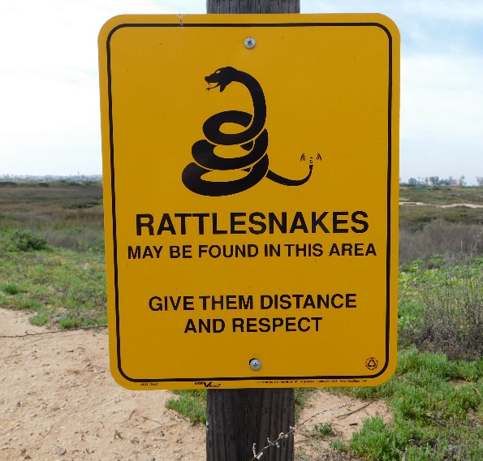
Consensus on principles
Environmental justice
Equal distribution
Equal opportunities
Intergenerational equality
Respect for nature

Slide 9
ARE WE READY TO
‘THINK GLOBALLY ACT LOCALLY?’

Slide 10
PART-2
PRACTICAL ISSUES

Slide 11
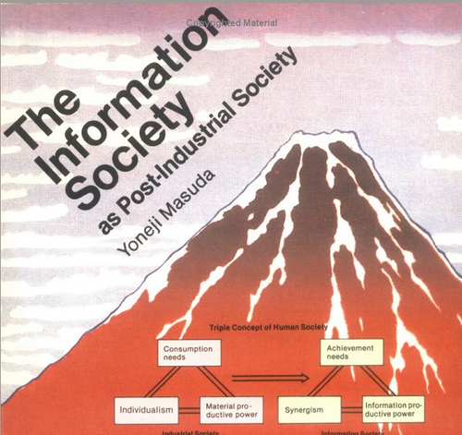
“Environmental ethics doesn’t go hand in hand with the modern industrial civilization”
Eco friendly civilization
Change consumerist lifestyle
Rectify unjust political order
Rebuild a philosophy that is morally responsible towards others and nature
Reform unequal economic system
Notes:
DISCUSS ethical issues in modern industrial civilization

Slide 12
"People are reluctant to share their environmental privileges"
Developing nations
Balance economic growth with environmental protection
Developed nations
Slow down on the use of resources

Slide 13
"Is poverty ended by or created by environmental degradation?"
Poor nation
Rapid economic growth = degradation of environment
Profits= pay debts
Environmental protection technologies?
Poverty of a nation turns out to be a reason for environmental degradation

Slide 14
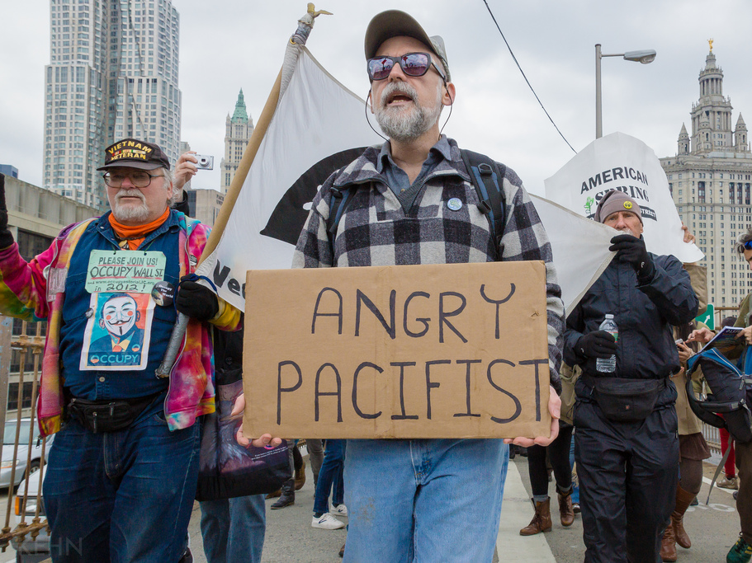
"They spend so much on military and not so much on environmental protection!"
An environmentalist must be a pacifist
Resist the deliberately created security threats by militant-industrial corporate groups

Slide 15
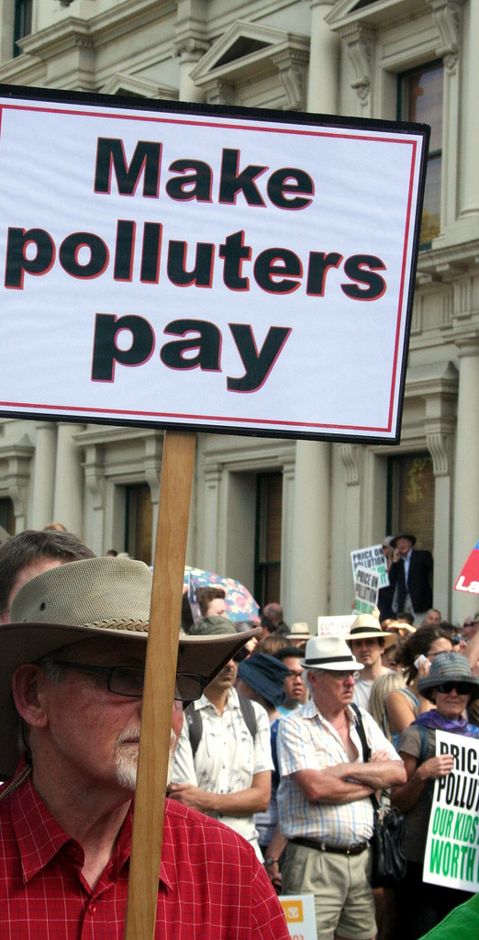
"Environmental degradation is not my problem!"
Restrictions on
Transferring heavily polluting industries
Exporting hazardous waste.

Slide 16
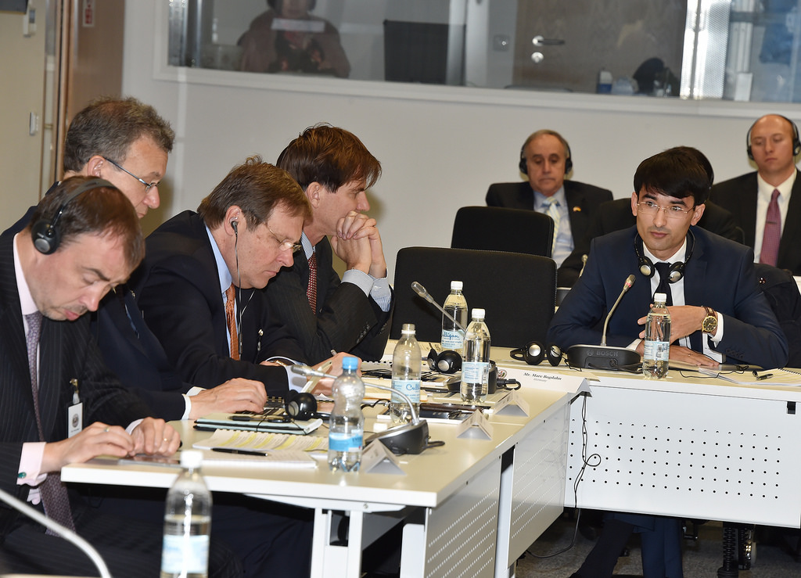
"Who makes the decisions anyway?"
Policy evaluation on
Economical
Political
Ethical terms

Slide 17
PART-3
INITIATIVES
Encourage research
Education
Capacity building

Slide 18
Encourage research
Remember, we are addressing the 'why' of environmental action
International conference
International declaration
World committee
Report
Award(?)

Slide 19
Education
Syllabus
Cooperation
Training

Slide 20
Capacity building
Example:LEAD
Knowledge transfer, e.g. efficient ways to use energy/resources
Safer international order

Slide 21
In conclusion...
Environmental justice is the key
No alternative to sustainable development (?)
Pacifism is a must

Slide 22
“Earth could be the ultimate object of duty, short of God, if God exists.” ~ (?)
Thank you!

